Slide 1
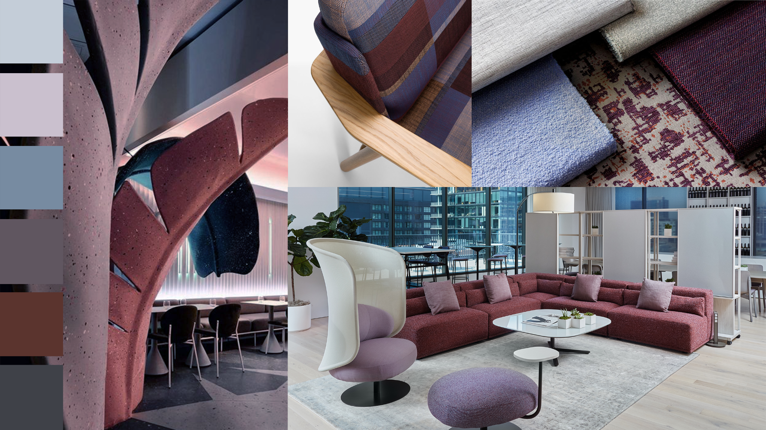
Notes:
The moodboard presents a gradient of cool to warm tones, starting from light, airy pastels and moving into deeper, more grounded shades:
The focus on soft, muted tones balanced by deeper accent colors creates an environment that is both calming and sophisticated. This concept is ideal for creating a high-end interior that feels both modern and timeless.

Slide 2
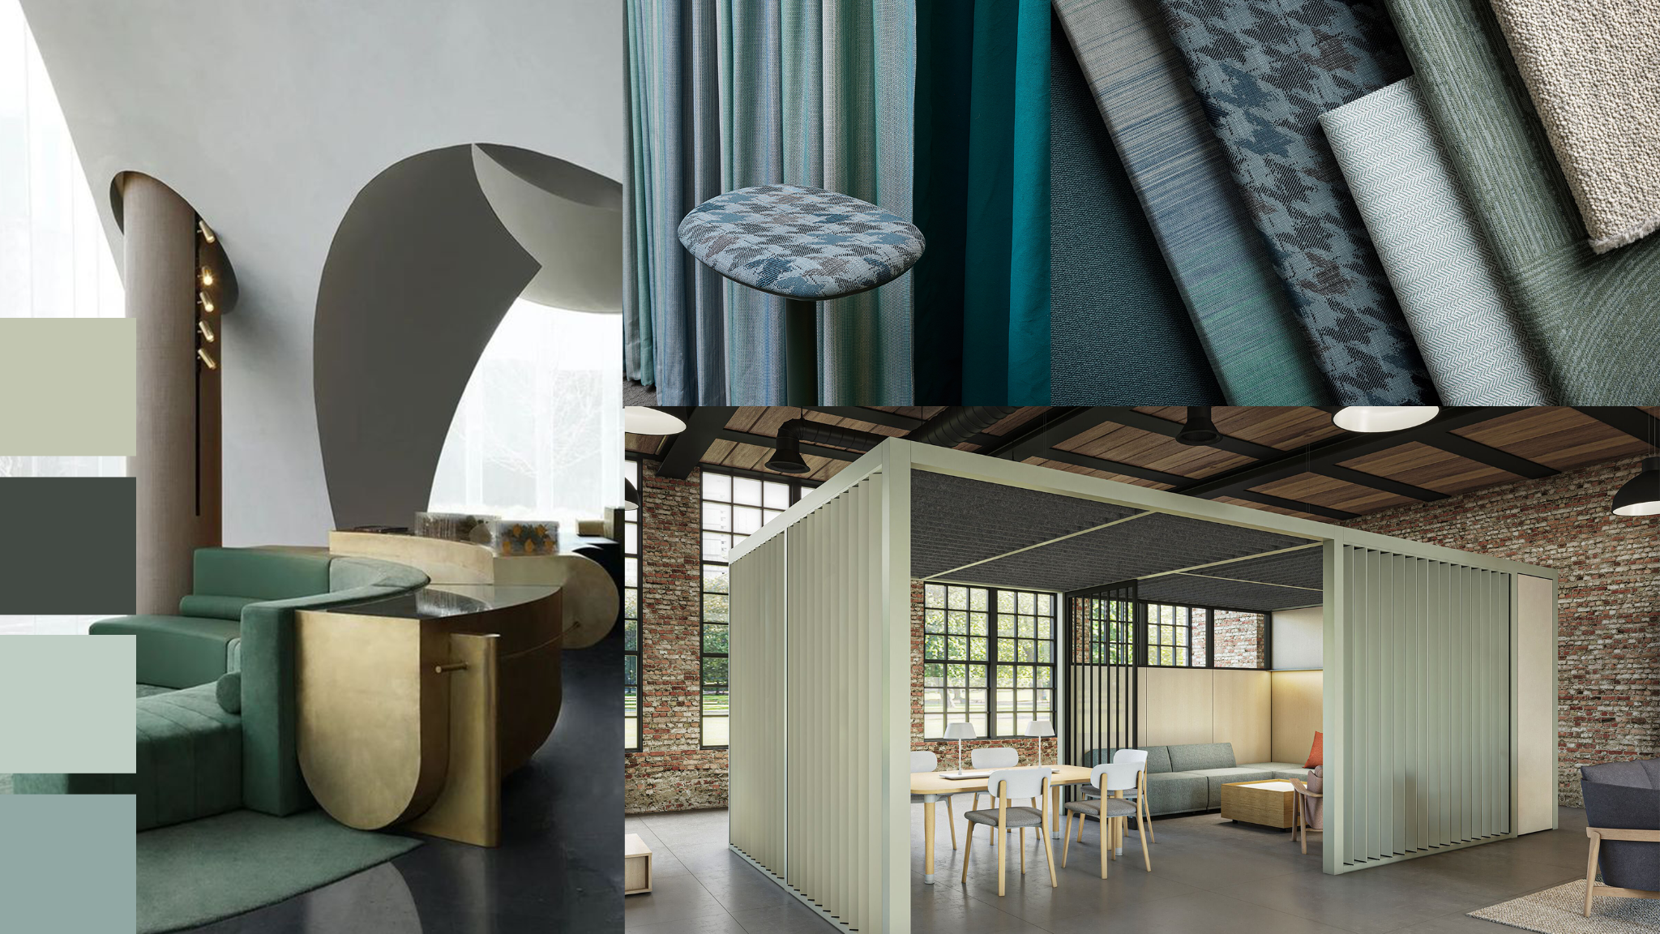
Notes:
The use of natural and muted greens ties the interior to the outdoors, creating a calm and relaxing environment. The accent paint choices are ideal in work scenarios or settings that prioritize calmness, focus, and a connection to nature. The cool, subdued hues maintain a professional feel, while the green brings in an element of nature, which can make the space feel more welcoming.

Slide 3
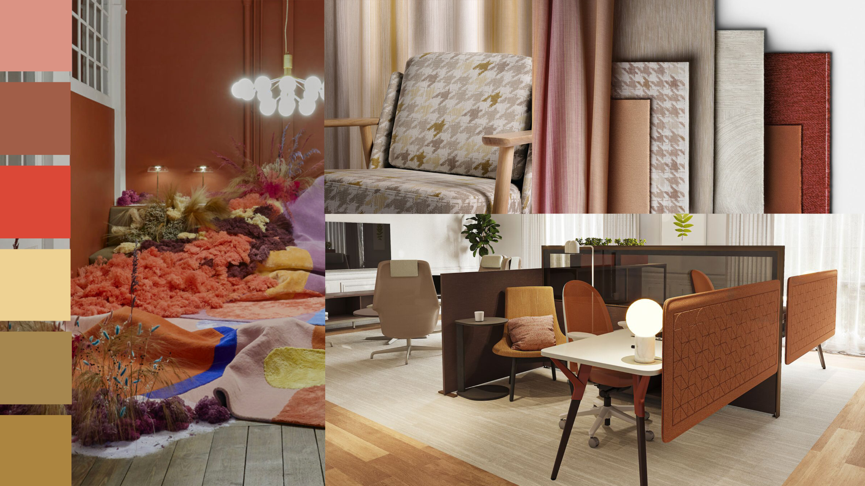
Notes:
This moodboard presents a vibrant, warm, and stimulating design concept with the use of rich, earthy tones. The accent paint colors are designed to complement the rich textiles and warm lighting, making the space feel inviting and energetic. Ideal for creative environments, this concept fosters both comfort and inspiration, making it perfect for social spaces, workspaces, or any area meant to spark creativity and interaction.

